Slide 1
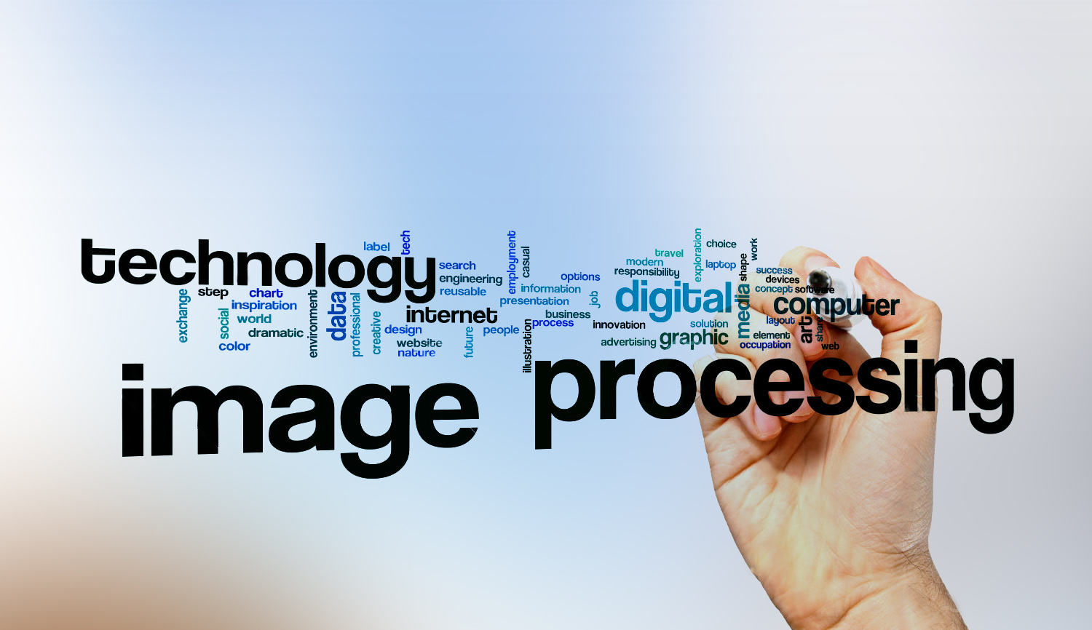
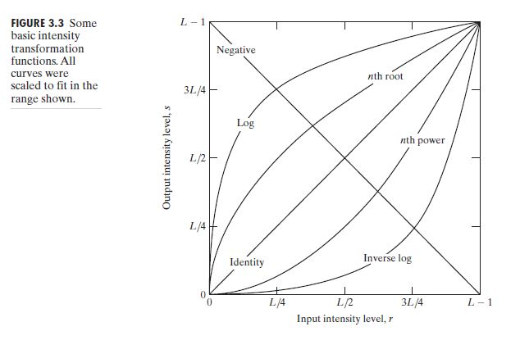

Digital Image Processing
17- Draw negative transformation

Slide 2
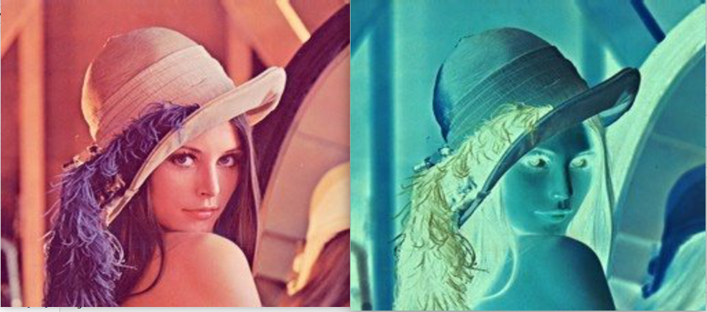
Digital Image Processing
17- Draw negative transformation

